Slide 1
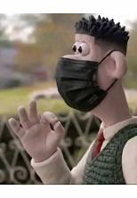
AI Merit Badge
Milestones of AI and Automation

Slide 2
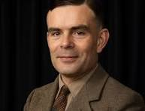
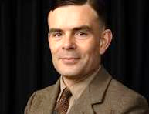
The conceptualization of AI and the Turing Test
Evil Alan Turing
Alan Turing
Imagined a computer that could think
past its specific programming way back
In the 1950s!

Slide 3
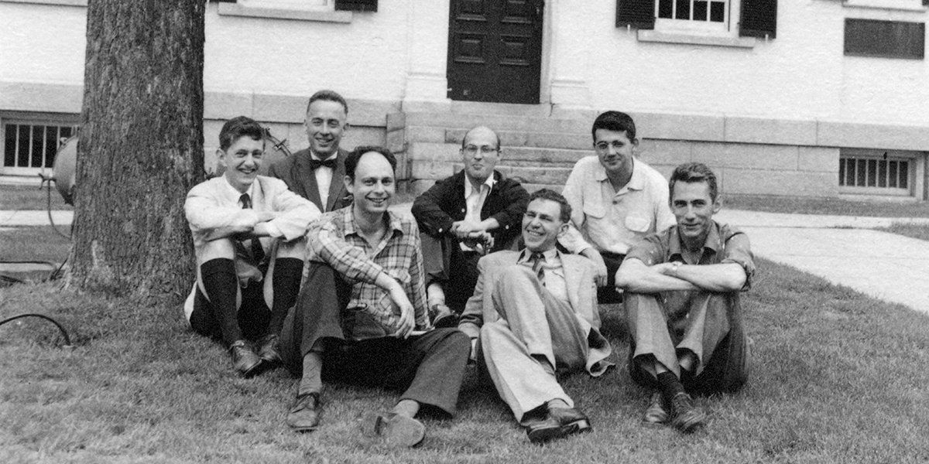
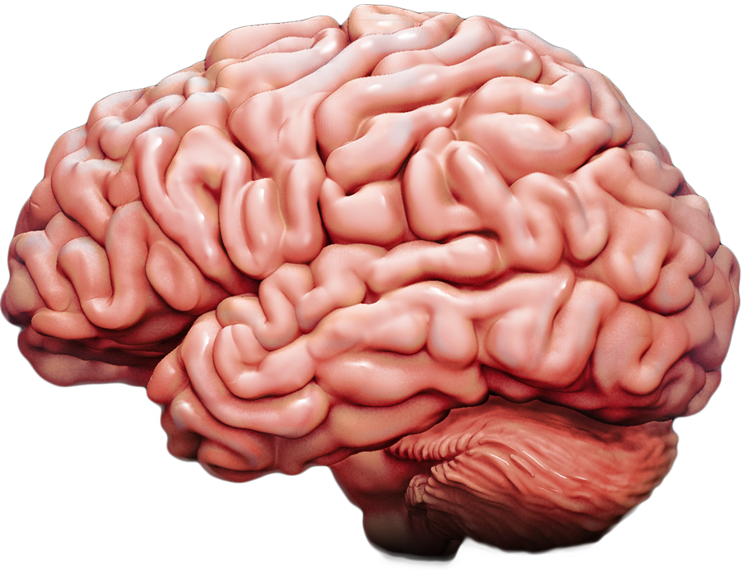
Dartmouth Conference 1956

Slide 4
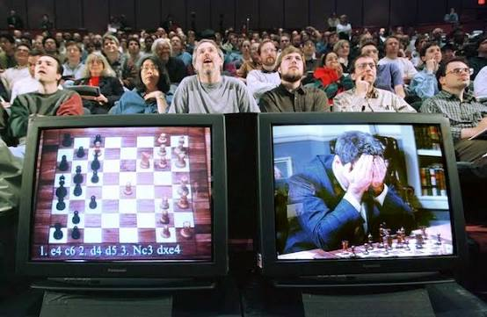
Deep Blue VS. Gary Kasparov

Slide 5
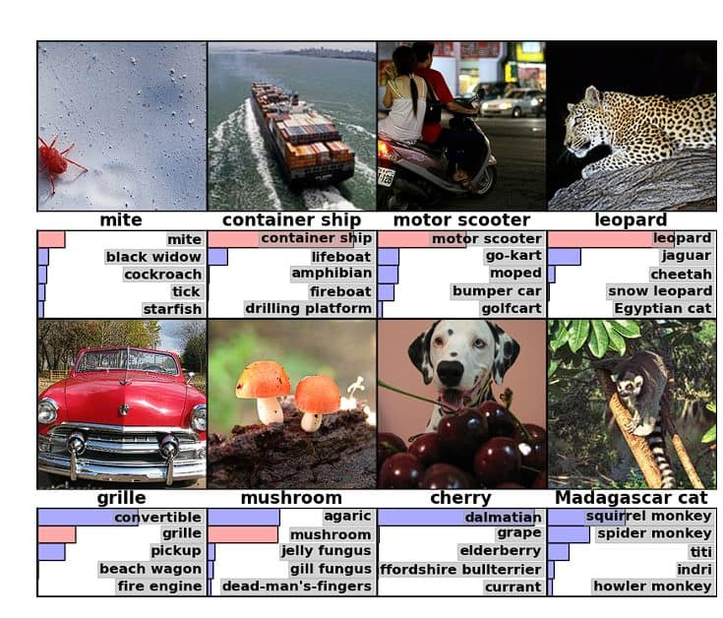
Alexnet Image Recognition

